Slide 1
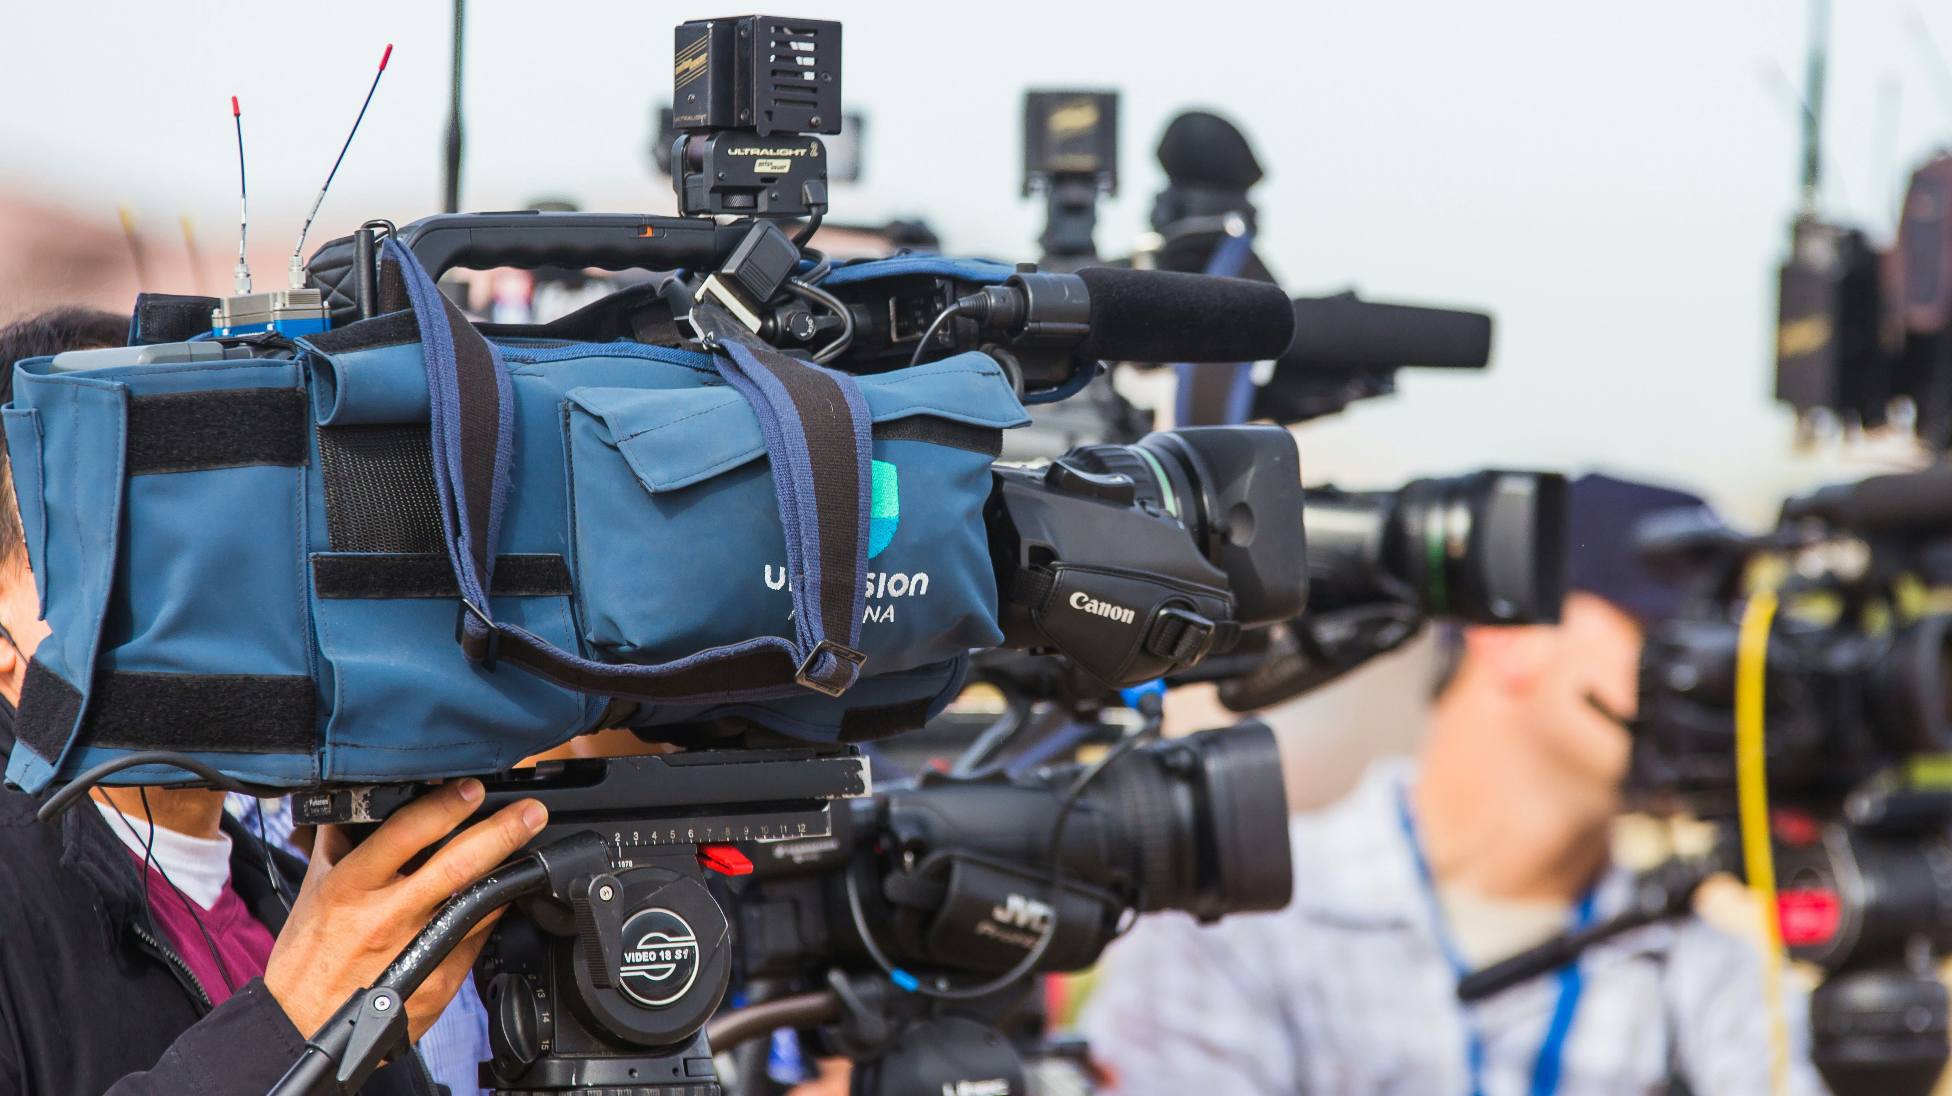
CMNS 2140 Media, Representation and Society
September 24
, 2026

Slide 2

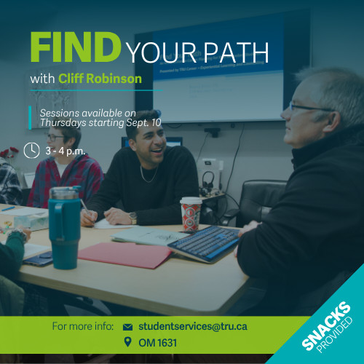

News and events
September 24 – Outdoor Movie and Food Trucks tonight
September 25-27 – Indigenous Film Festival
Today and any of the next four Thursdays 3:00-4:00
  Find Your Path

Slide 3
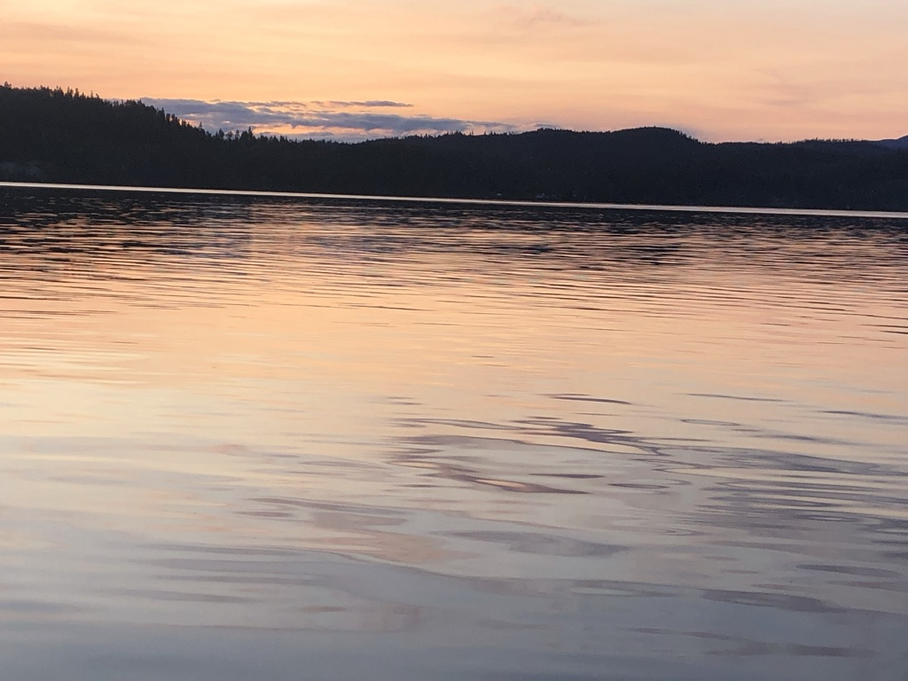
Territorial Acknowledgement

Slide 4

Where we’re going today…
SOCC framework
Practice
Selecting your media object for Unit One assignment

Slide 5
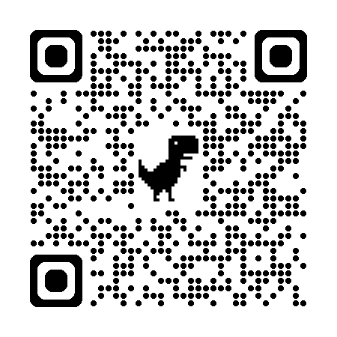

Group A | Group B
2017 Advertisement | Late 1970’s Advertisement

Slide 6
Preparing for next class
  Have your media object ready to discuss

