Slide 1
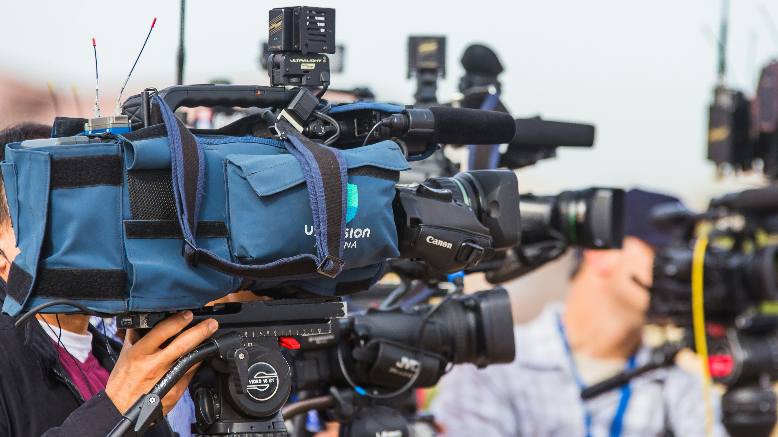
CMNS 2140 Media, Representation and Society
September 17, 2026

Slide 2

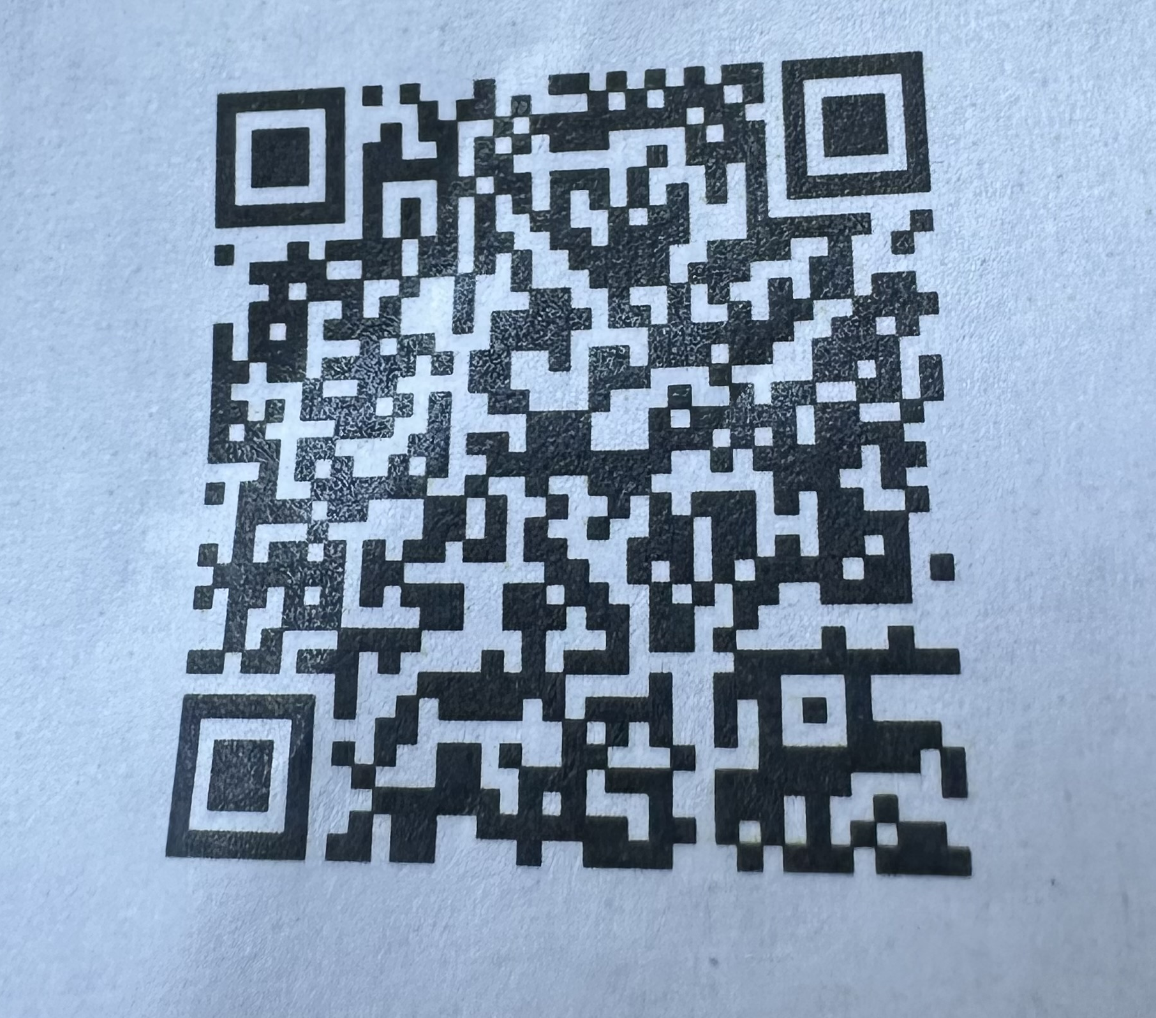
News and events
TODAY – TRUSU Clubs Day and Community Fair
September 24 noon – TRUSU Community Meal
September 24 evening – TRUSU Outdoor Movie Night and Food Truck Festival (movie is Michael)
September 25 – Canadian Assoc of Journalists Panel
September 29 – Open Mic Night

Slide 3
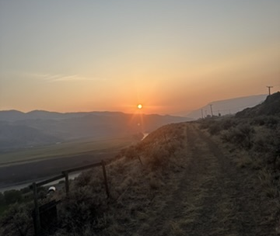
Territorial Acknowledgement

Slide 4
Where we’re going today…
Key course concepts for Unit One (seeing) assignment
  Representation
  Sign
  Connotation
  Denotation
  Discourse

Slide 5
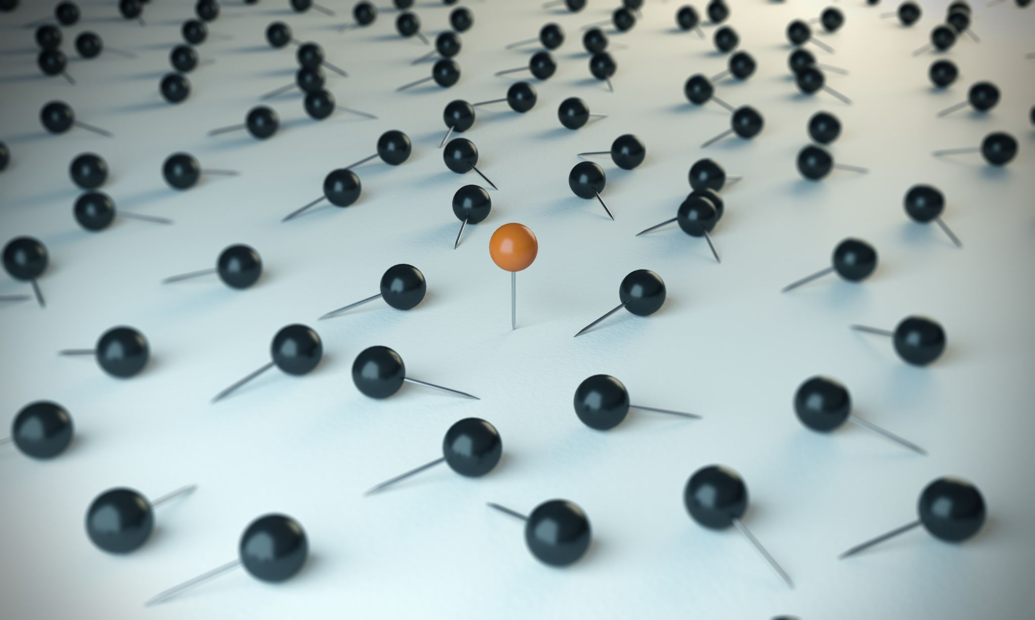
But first, I found the Padlet responses

Slide 6
Our learning outcomes today
Explain why representation is a construction, not a neutral reflection of reality.
Define
  representation
  sign, signifier, signified
  denotation and connotation
  discourse
Take apart a media image into its denotative and connotative layers.
Be prepared to apply these terms to a the research article

Slide 7
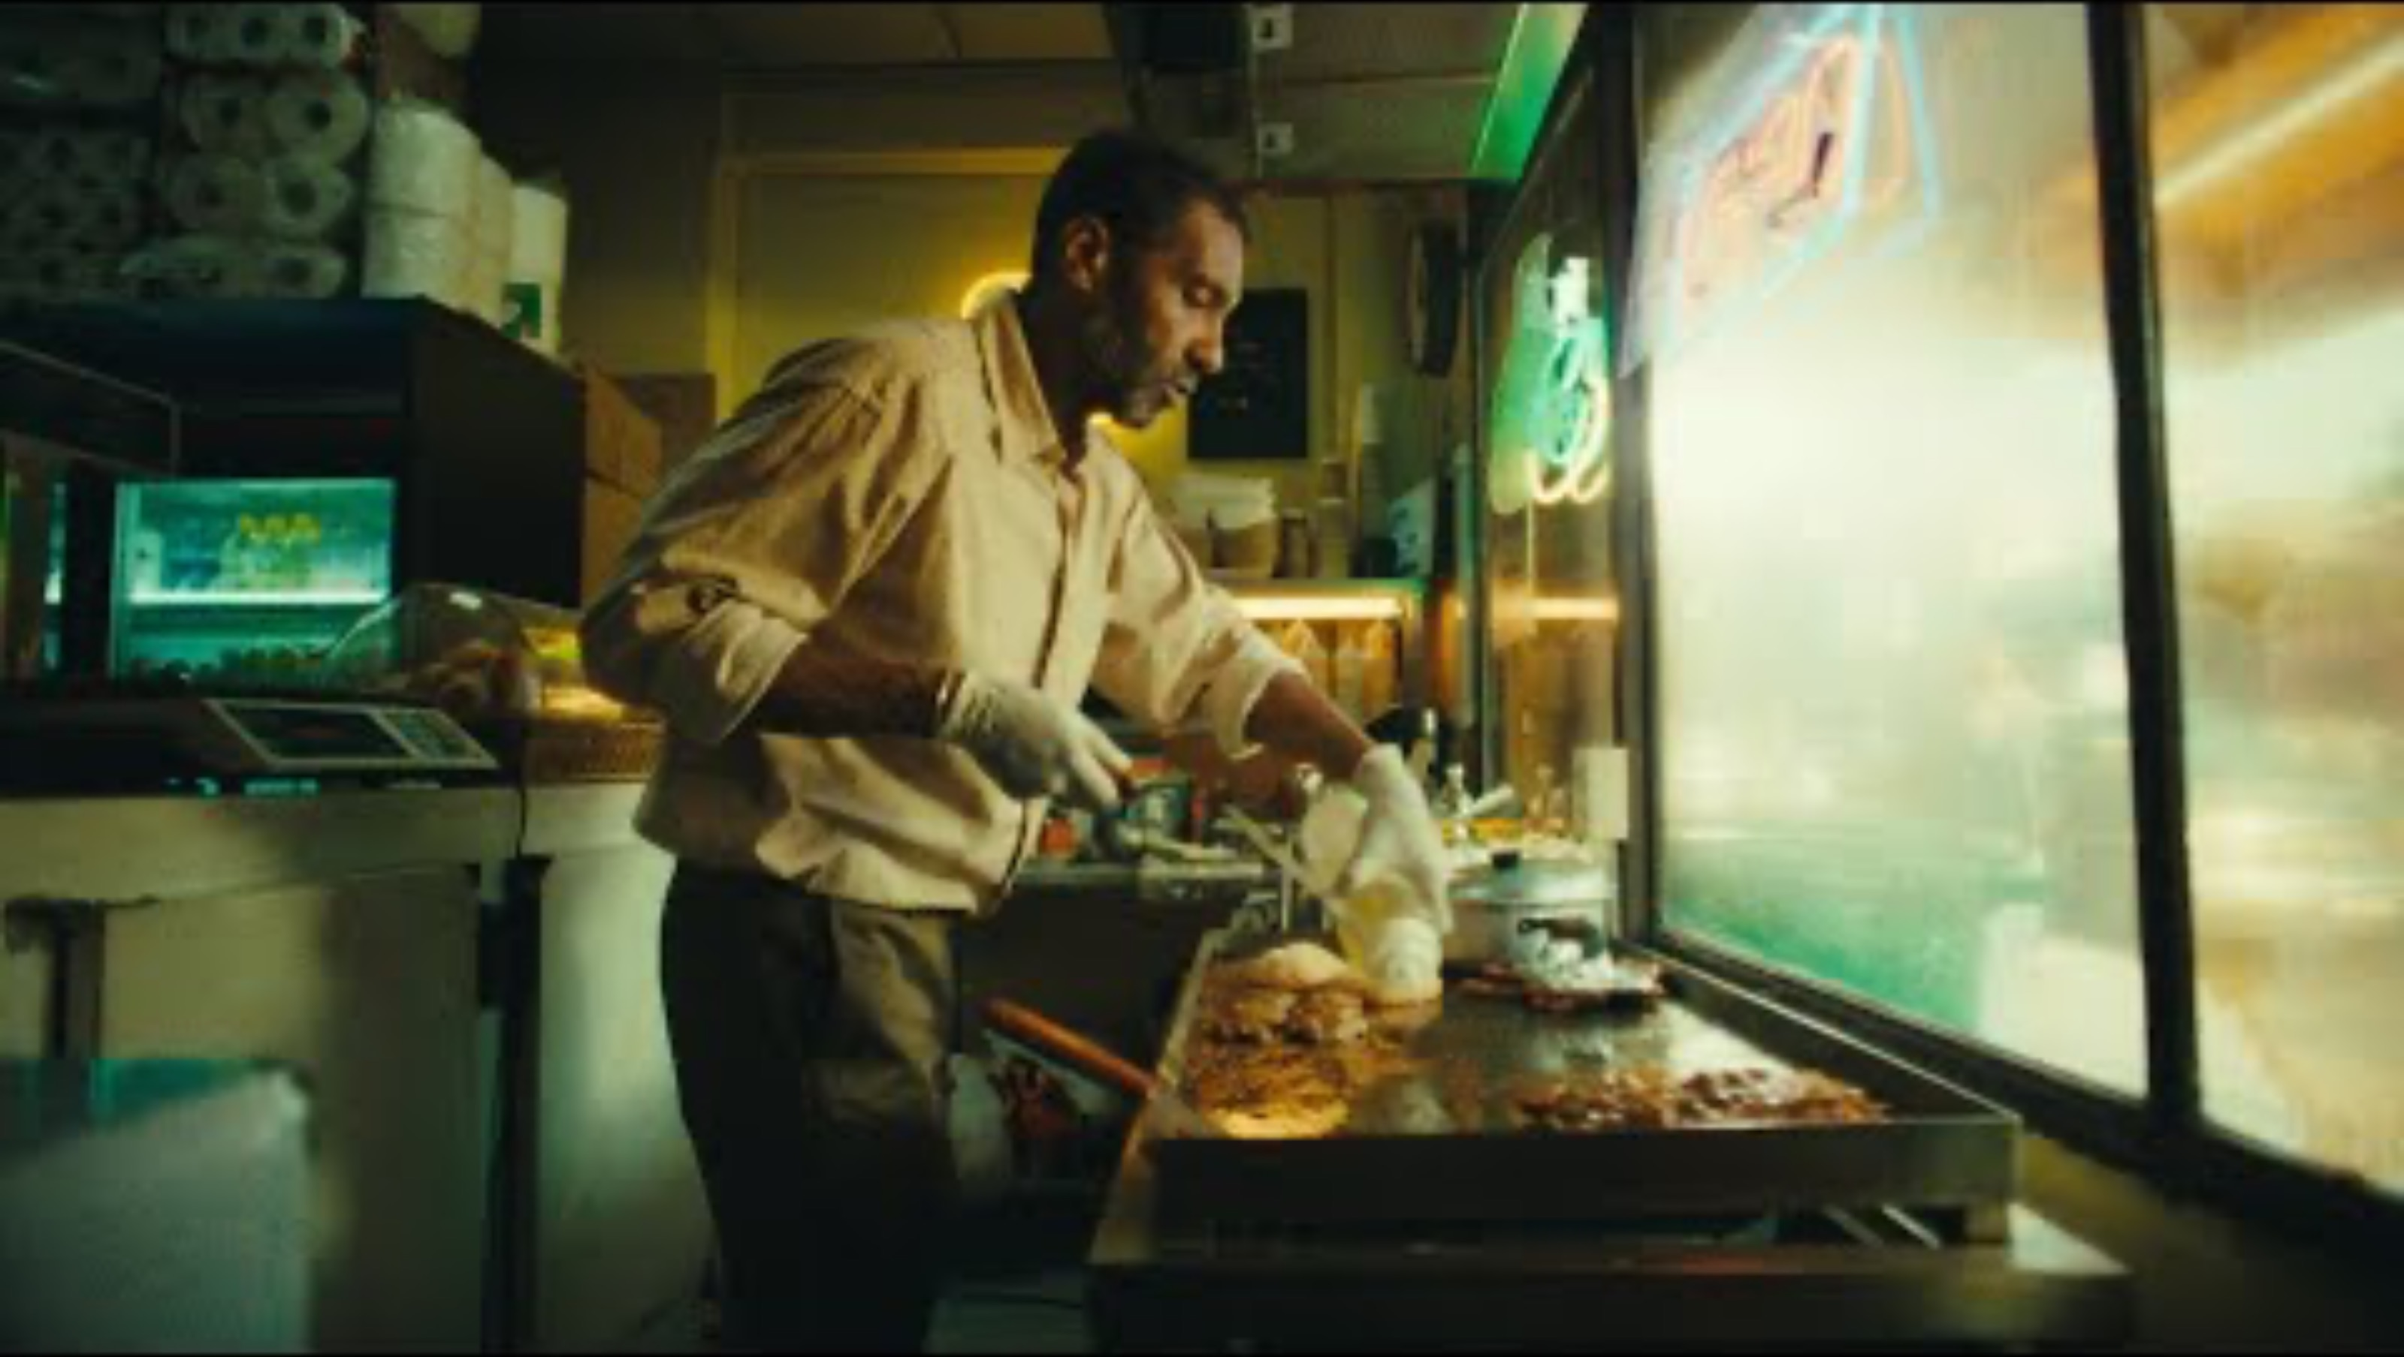
Media doesn't reflect the world, it constructs it
That selection process is what Unit 1 gives you the vocabulary to name.

Slide 8
The habit you will develop in this course
whenever a media object feels “obvious” or “natural,” that’s the moment to ask what work the sign, the connotation, and the discourse are doing to make it feel that way

Slide 9
Representation
Signs (words, images, sounds) stand in for a concept, person, or thing, and thereby produce meaning about it
Reflective view
Constructionist view

Slide 10
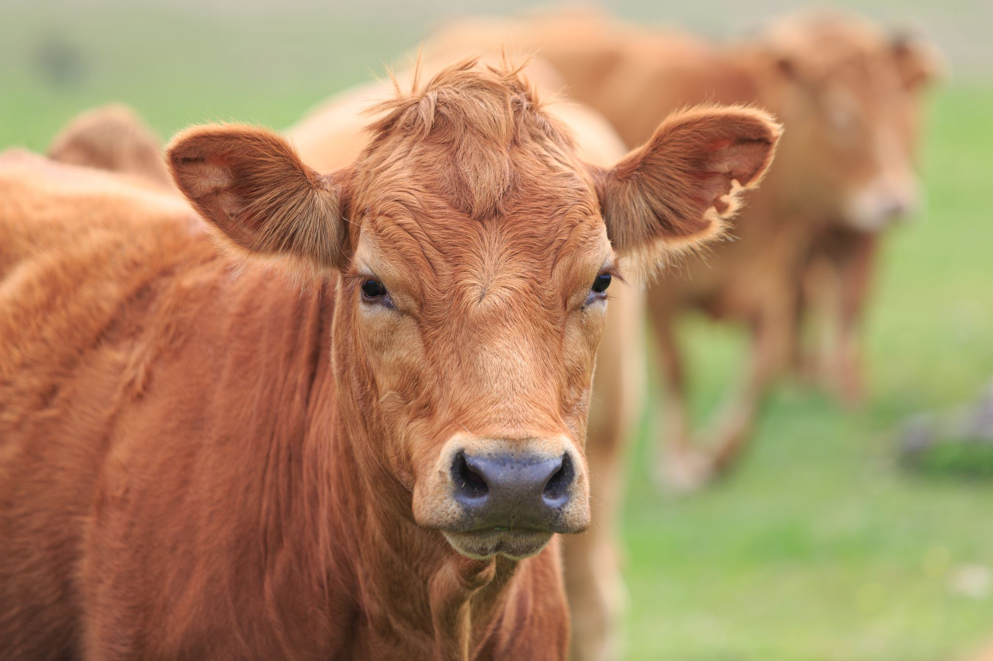
The Sign
Every sign has two parts
  Signifier: the word “cow,” or a drawing of one.
  Signified: the mental concept, the animal itself.
The link is arbitrary: nothing about the sound “cow” resembles a cow. It only works because a language community agrees on the code.
Because the pairing is learned so early and used so constantly, it starts to feel natural, as if the sign simply IS the thing. It isn't.

Slide 11

And, yes, colours can be signifiers too…

Slide 12
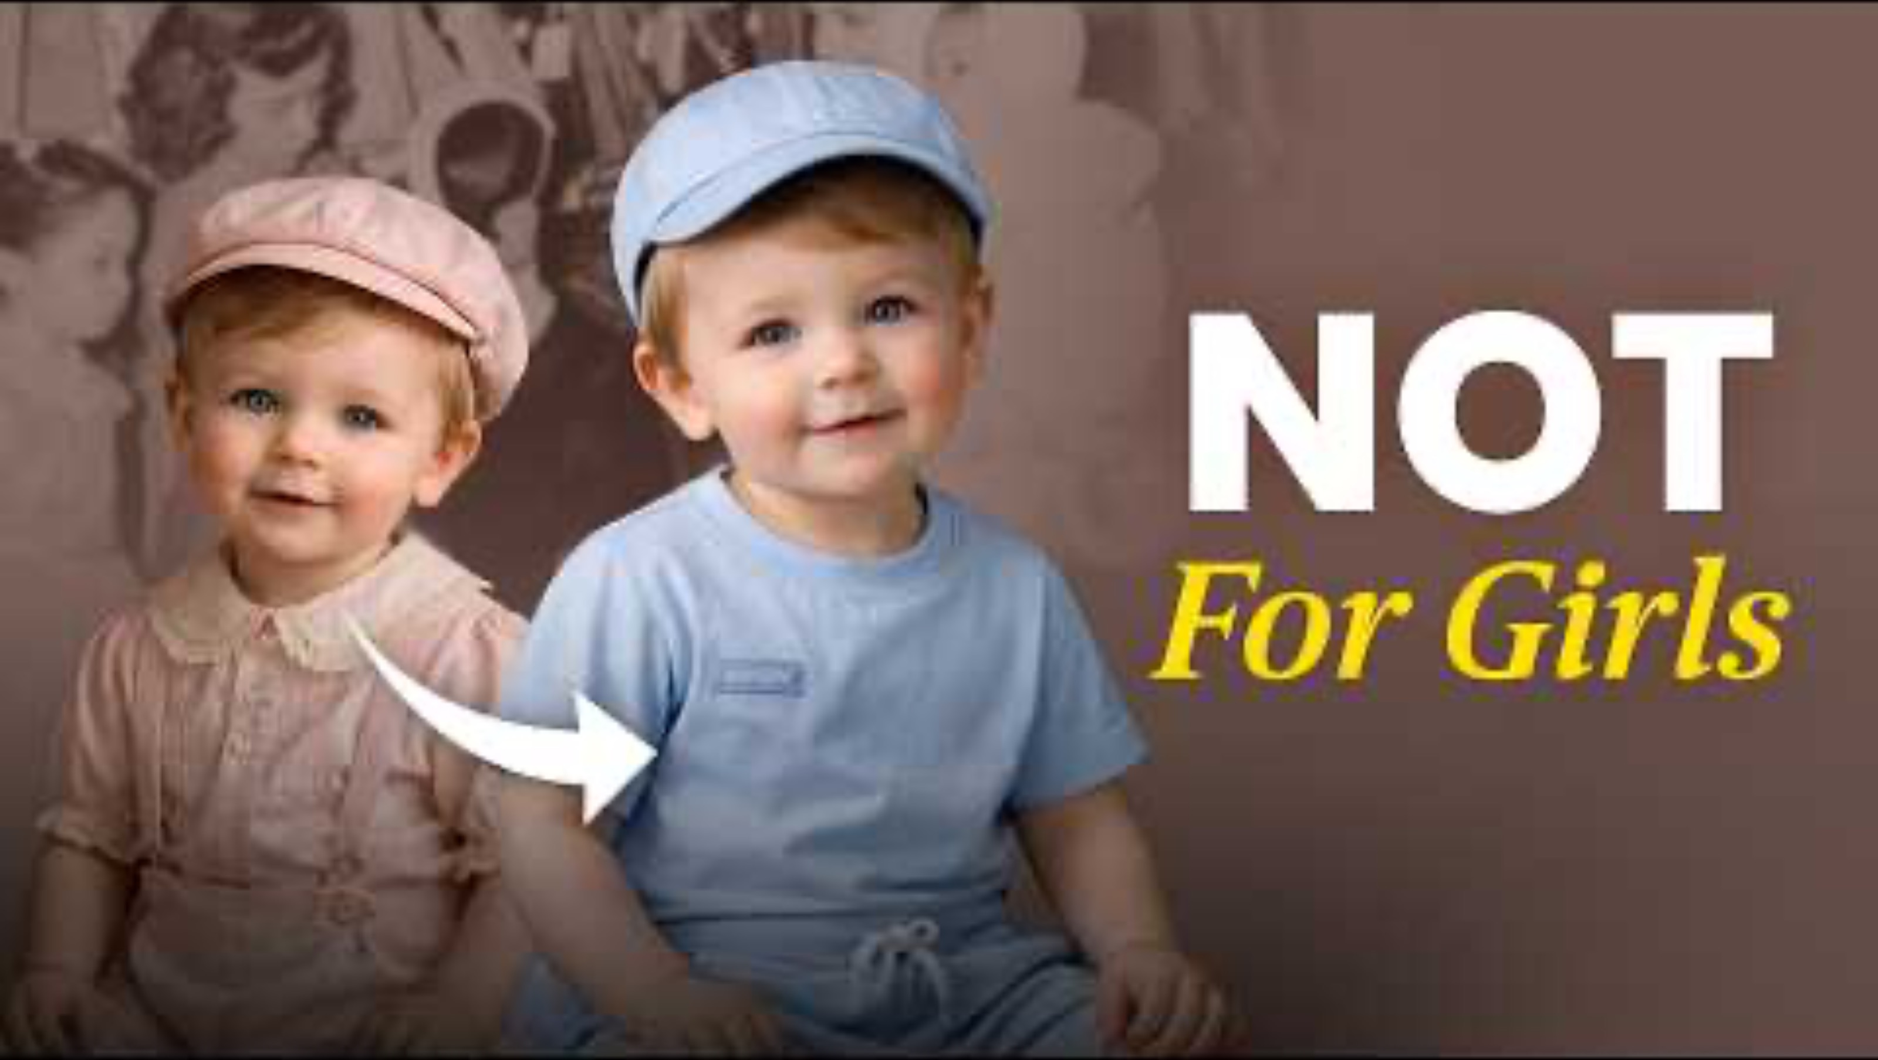
But was this always so?

Slide 13
Denotation & Connotation
Denotation - What is objectively there.
Connotation - The cultural, associative meaning.
Barthes's example, a sweater: denotes “a warm garment.”
Depending on context, it can connote “the coming of winter,” “a romantic autumn walk,” or “haute couture style.”
Same object, same denotation, but which connotation activates depends on the visual styling, the surrounding text, and the discourse it's placed in.

Slide 14
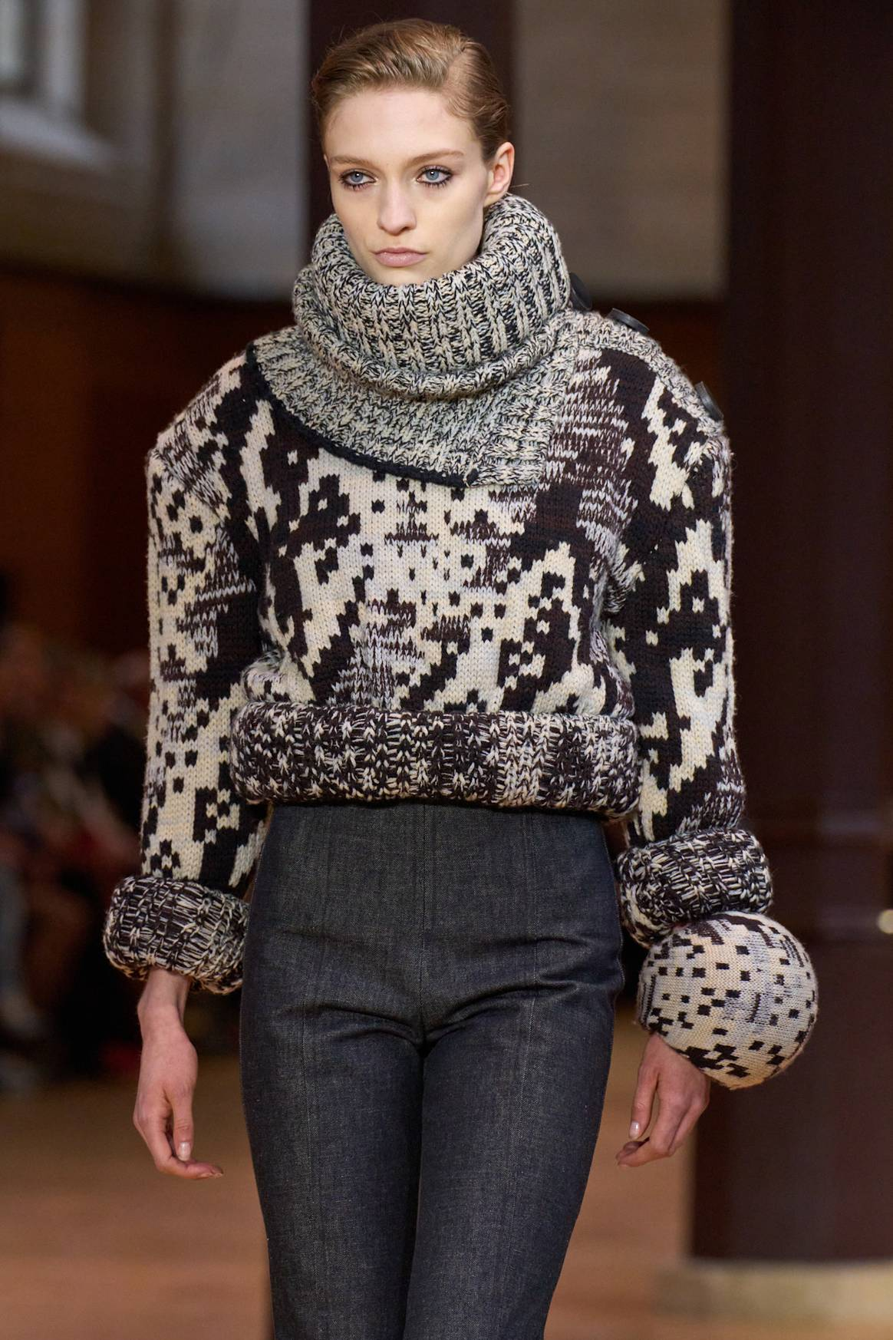

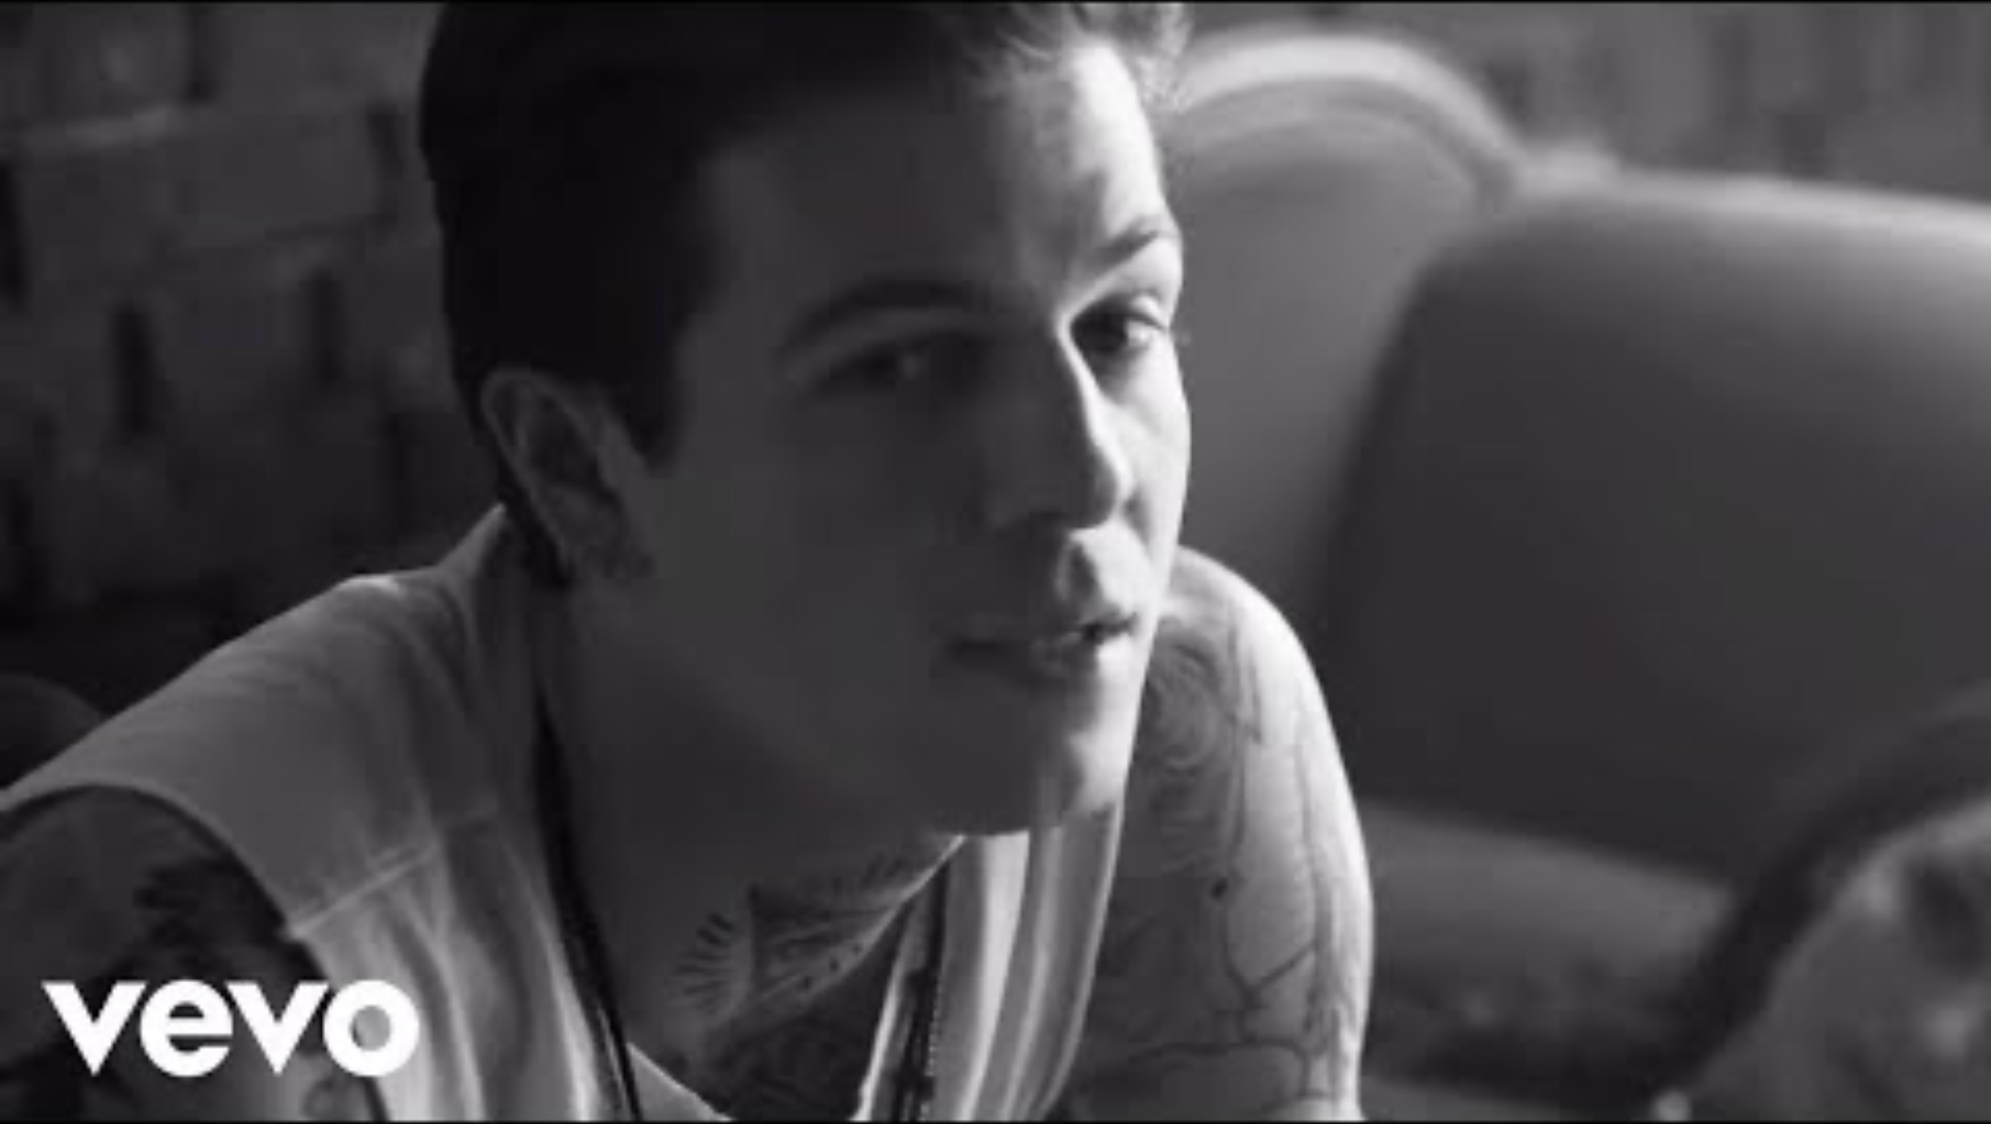

Slide 15
Discourse
A discourse is not just “talk.” It's a system of representation: a set of rules, categories, and assumptions that governs what can be said, shown, or thought about a topic, in a given context.
News discourse: what counts as a legitimate source, a balanced story, a “real” event.
Advertising discourse: what counts as desirable, aspirational, normal.
Medical discourse: what counts as a symptom, a disorder, a treatment.
Discourses set the “maps of meaning” that make a sign's connotation feel like common sense, and they carry power: some readings get preferred, others get pushed to the margins.

Slide 16
How the pieces connect: From sign to power
Sign: signifier + signified, held together by convention.
Denotation: the literal layer everyone agrees on.
Connotation: the associative layer, shaped by context.
Discourse: the wider system that makes one connotation feel natural.

Slide 17

Let's try a quick example, together
Sign
Denotation
Connotation:
Discourse

Slide 18

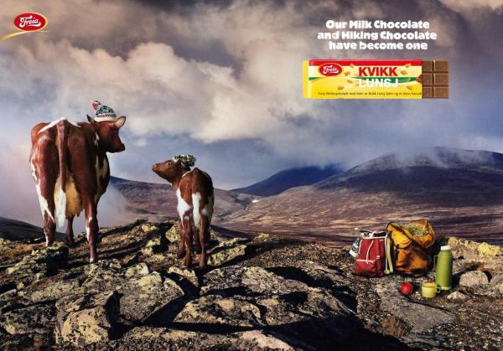
link

Slide 19
Why this matters next: This is the toolkit for your Media Audit
The Media Audit (Unit 1 submission) asks you to identify representation-as-construction in a media object of your choice, using this unit's vocabulary, with specific evidence.
To get “complete,” you need to actually apply the concepts to evidence, not just assert them. Today's activity is that move, in miniature:
  Name the sign, precisely.
  Separate denotation from connotation.
  Trace the connotation to a discourse.

Slide 20
Before you go: Five terms, One habit of mind
Representation, sign, denotation, connotation, discourse.
The habit: whenever a media object feels “obvious” or “natural,” that's the moment to ask what work the sign, the connotation, and the discourse are doing to make it feel that way.
Next class: we stay in Unit 1 and start applying these terms to a shared example, building toward your Media Audit.

Slide 21
Preparing for next class
  Be prepared to discuss the research article in Tuesday’s class

